Slide 1
Industrial Revolution
1700-1915

Slide 2
Enduring Understandings
1. The motives of competition and profit often prompt people and groups to expand into new areas of opportunity.
2. Changes in technology and exchange during the 18th and 19th centuries led to the social and economic changes around the world that are still relevant today.
3. Technology, transportation and communication enabled European nations to become the dominant world powers in the 19th century.
4. Centers of global economic and political power shift over time.
5. Technology and industrial advancement can alter existing social and economic systems.

Slide 3
Essential Questions
1. How can nationalism be a unifying and a divisive force?
How does a state gain or lose power over others?
2. How should resources and wealth be distributed?
3. Why do political revolutions occur?
Guiding Questions:
Was imperialism a necessity for industrialized nations?
How has technology and exchange transformed societies and the human experience?
How did imperialism mutually affect the colonizer and the colonized?
What circumstances allow societies to become dominant?
What responsibility do people with power have to those with less power? Did the industrial revolution bring true progress to the world?

Slide 4
Imagine, if you will…
That you are at home engaged in one of your favorite activities; playing a game, listening to music, or reading. So far the day is as any other. Then all of the sudden a group of individuals arrive at your front door demanding that you stop what ever you are doing. These individuals tell you that your way of life is wrong. They inform you however that they have come to your house to correct your way of life. They say it is their responsibility to change your way of living for the better. You find out that this has happened not only to you but your neighbors as well. Over time your way of life does change. These individuals, who you do not even know, have changed your government, religion, and other cultural practices, and remember these individuals told you this was for your own good. What is your reaction?

Slide 5
Discuss with a partner and respond to the following quotes- what do you think?
1. "To think of these stars that you see overhead at night, these vast worlds which we can never reach. I would annex the planets if I could; I often think of that. It makes me sad to see them so clear and yet so far."
2. “We must find new lands from which we can easily obtain raw materials and at the same time exploit the cheap slave labor that is available from the natives of the colonies. The colonies would also provide a dumping ground for the surplus goods produced in our factories.”
3. "I contend that we are the first race in the world, and that the more of the world we inhabit the better it is for the human race...If there be a God, I think that what he would like me to do is paint as much of the map of Africa British Red as possible...“
4. "In order to save the 40 million inhabitants of the United Kingdom from a bloody civil war, we colonial statesmen must acquire new lands to settle the surplus population, to provide new markets for the goods produced by them in the factories and mines..."

Slide 6
What is the Industrial Revolution?
Started in England, soon spread through Europe and the US
Paving the way for modern industrial societies
A shift beginning in the 18th century from hand-made goods to man-made and machine made production

Slide 7
In the beginning…
Agricultural Revolution
Enclosures- fenced (hedged) in fields by wealthy landowners, once owned by small village farmers
Experimented with new agricultural methods
Forced small farmers to rent land or move to cities
Crop Rotation- rotation of crops to different fields each season produced higher crop amounts

Slide 8
Crop Rotation

Slide 10
New Methods
Jethro Tull
The Seed Drill
Sow seeds in well placed rows & depths
Better germination
Less waste
Robert Bakewell
Only
best bred sheep
Others followed
Avg. weight climbed 18-50 lbs

Slide 11
England’s Advantage~ 1700’s
Population
Large population of workers
Natural Resources
Water power
Coal and iron ore
Rivers for inland trade
Many harbors for international trade
Economic Strength
Parliament’s passed laws in support of entrepreneurs
Financially successful colonies with abundant resources
Political Stability
Isolated from European wars (not on British soil)
Parliamentary system successful for 100’s of years

Slide 12
British has Factors of Production
Natural Resources
Used colonies to provide raw materials
Human Resources
Farmers move to cities; large work force
Capital Recourses
More $$ in middle class to increase production
More modern tools allow mass production
Entrepreneurs
Upper middle class become industry leaders
Emergence of capitalism allows more to get rich

Slide 13
England 1701 & 1911

Slide 14
Inventions in Textile Industry
Eli Whitney’s Cotton Gin boosts US production
1.5 mil lbs in 1790
85 mil. lbs. in 1810
Britain's textiles clothed the world
John Kay’s “flying shuttle”
Doubled productivity
James Hargreaves “spinning jenny”
Eight threads at once
Richard Arkwright’s water frame
Water power to drive spinning wheel
Samuel Compton’s “Spinning mule”
Combined jenny and mule
Stronger, finer, consistent thread
These bigger looms required factories, build near water

Slide 15
Transportation Improvements
With greater need to move goods, transportation rapidly improved
Better roadways, canals, tunnels, etc.
Steam engine
Steam boats
Railroads
Extensive systems become necessity
Factory engines

Slide 16
Steam Engine

Slide 17
Fulton’s Steamboat

Slide 18
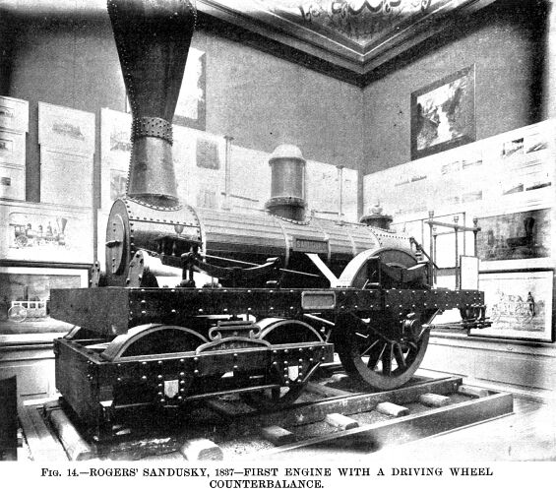
Locomotives

Slide 19
England’s Railroad System -1850
Industrial Revolution Handout

Slide 20
Industrialization

Slide 21
Industrialization
Growth of industrial cities
Factories for efficient production
Urbanization: rapid movement to cities
Poor living conditions
Small cities became too big too fast
Poor sanitary conditions
Insufficient housing, education, security
Air and water pollution

Slide 22
Urbanization
- City building and the movement of people to cities

Slide 23
Urbanization

Slide 24
Living Conditions
Tenements

Slide 25
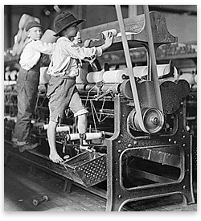
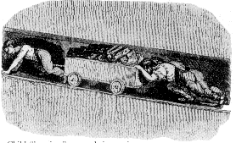
Industrialization
Poor Working conditions
14 hour days, 6 days/week, poor pay
Workers had to keep up with machines
Child Labor

Slide 26
Child Labor

Slide 27
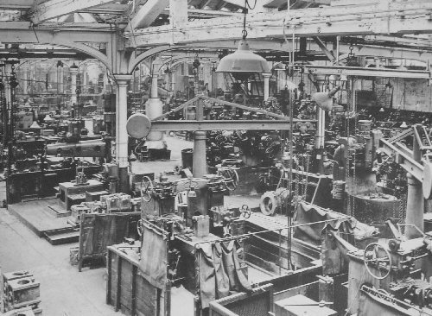
Working Conditions

Slide 28
Class Tension
Rise of Middle Class- social class of skilled workers, professionals, business people and wealthy farmers
Upper Middle Class: Factory owners and merchants grew wealthy and influential in politics
Lower Middle Class: factory foremen, skilled tradesmen, supervisors lived comfortably
Poverty stricken working class replaces peasant class
Tension b/w classes builds
Aristocracy resents Upper Middle Class
Being pushed out of power
Workers resent Upper Middle Class
Gap between classes getting larger
Frustrated over being replaced by machines

Slide 29
Industrialization Spreads

Slide 30
Global Impact
Industrialization moved through Europe and to the US (West)
More demand for products created more demand for raw materials
Motivation for more colonization = IMPERIALISM
Global Inequality
Industrialized West vs. all the rest
Great economic and military inequalities
Transformation of Society
Great economic power of Europe
More wealth overall
Better opportunities for education and democracy

Slide 31
The Age of Economic Reforms
The Industrial Revolution led to economic, social, & political reforms

Slide 32
Age of Economic Reform
ECONOMIC SYSTEM: policies of production, distribution and consumption of goods and services
Business leaders encouraged gap between rich and poor
LAISSEZ-FAIRE: “hands-off” economy
Promotion of CAPITALISM
Reformers encouraged governments to play a more active role in bettering conditions
Emergence of SOCIALISM and COMMUNISM

Slide 33
Age of Economic Reform
ECONOMIC SYSTEM: policies of production, distribution and consumption of goods and services
Business leaders encouraged gap between rich and poor
LAISSEZ-FAIRE: “hands-off” economy
Promotion of CAPITALISM
Reformers encouraged governments to play a more active role in bettering conditions
Emergence of SOCIALISM and COMMUNISM

Slide 34
Capitalists
Adam Smith-
father of modern capitalism
Economic liberty guaranteed economic progress
Malthus
Wars and epidemics necessary to reduce excess population- reduce number of poor
Ricardo
Permanent underclass always poor
Wages forced down as population increase = supply & demand

Slide 35
Capitalists
Adam Smith-
father of modern capitalism
Economic liberty guaranteed economic progress
Malthus
Wars and epidemics necessary to reduce excess population- reduce number of poor
Ricardo
Permanent underclass always poor
Wages forced down as population increase = supply & demand

Slide 36
Socialists
Bentham:
UTILITARIANSIM: judge ideas, institutions and actions on the basis of their utility or usefulness
Government should provide the greatest good for the greatest amount of people
Karl Marx:
Believed that economic forces controlled society
Wrote the Communist Manifesto (1848) calling for “workers of the world unite” and overthrow the “bourgeoisie”
Radical socialism called Marxism
Gap between rich and poor too wide and will widen
More control over economy will reduce class conflict
VIDEO : Crash Course: Capitalism and Socialism

Slide 37
Marxism
All great movements in history are the result of what?
An economic class struggle
The “haves” do what?
Take advantage of the “have-nots” (workers)
The Industrial Revolution intensified what?
The class struggle
Workers are what?
Exploited by employers
The labor of workers creates what?
Profit for employers
The capitalist system – along with the state– will eventually do what?
Destroy itself, or wither away, as a classless society develops

Slide 38
Marxism
Factories drive small artisans out of business
Small # of manufacturers to control wealth
Large PROTELTARIAT would revolt & seize factories

Slide 39
Marxism
Proletariats would produce what was NEEDED
Workers would share profits
Creation of economic equality

Slide 40
Marxism
Workers would control gov’t in “Dictatorship of the Proletariat”
Create cooperative living and education
The state/government would wither away = classless society

Slide 41
Marxism to Communism
Marx’s final phase would become…
COMMUNISM - complete form of socialism in which the means of production owned by the people
no private property
classless society
All goods and services shared equally

Slide 42
Communism
Marx’s ideas of communism didn’t have much appeal until 20th century
Lenin’s Russia
Mao’s China
Ho Chi Minh’s Vietnam
Castro’s Cuba
Most of Marx’s predictions never occurred proving that society is not just controlled by economic forces but also by religion, nationalism and political forces

Slide 43
Economic/Social Reforms
Workers used their #’s and became more active in politics
Unions: voluntary worker’s associations
Collective Bargaining
Strikes
Reduction of Child Labor
Better working conditions and pay
Women’s rights movements in GB and US
Education reform- public schools

Slide 44
Are we able to?
1. Analyze the motives behind European imperialism.
2. Describe the technological advantages Europeans possessed that enabled them to control large areas and populations. 3. Analyze the impact imperialism had on the colonizer and the colonized both then and now.
4. Use maps to illustrate changing political boundaries in Africa.
5. Compare and contrast different methods of imperialism across the globe.
7. Analyze how the growth of capitalism and urbanization in the Industrial Revolution affected the environment and lives of people.
8. Explain the social, economic, and political causes and effects of the industrial revolution in Europe.

Slide 45
THE END

